Slide 1


Industrial/Organizational Psychology
[Professor Name]
[Class and Section Number]
Notes:
Classroom Recommendations: This lecture can be completed in a single class period. If you need to shorten it, you can remove some of the activities. If you want or need to lengthen the lecture, you can add in activities from the module.
Overview: This chapter provides an introduction to industrial and organizational (I/O) psychology. I/O psychology is an area of psychology that specializes in the scientific study of behavior in organizational settings and the application of psychology to understand work behavior. The U.S. Department of Labor estimates that I/O psychology, as a field, will grow 26% by the year 2018. I/O psychologists typically have advanced degrees such as a Ph.D. or master’s degree and may work in academic, consulting, government, military, or private for-profit and not-for-profit organizational settings. Depending on the state in which they work, I/O psychologists may be licensed. They might ask and answer questions such as “What makes people happy at work?” “What motivates employees at work?” “What types of leadership styles result in better performance of employees?” “Who are the best applicants to hire for a job?” One hallmark of I/O psychology is its basis in data and evidence to answer such questions, and I/O psychology is based on the scientist-practitioner model. The key individuals and studies in the history of I/O psychology are addressed in this module. Further, professional I/O associations are discussed, as are the key areas of competence developed in I/O master’s programs. The goal for this unit is two fold: First, to help students understand the breadth of psychology in terms of areas of study and possible careers, and second, to introduce students to the often ignored, misunderstood, or completely unknown area of psychology called IO psychology. One fun warm-up activity you can do is ask the students what they THINK an organizational psychologist does. Inevitably, they guess that it’s the psychology of being organized. Though incorrect, it can be a fun way to introduce the topic!
Technical Note:
These slides may contain simple click animation so that you can focus students’ attention on a particular question, a selection of text, or an image and not have them be distracted by reading ahead. You can either preview the sequence of animation by going through the slides in slideshow view, visiting the animations tab, or reviewing the slide notes. In the notes you will see a cue - (Click) – that corresponds to each animation.
You may also find hyperlinks to outside videos at various places in the slides. These hyperlinks are embedded in text and indicated by color and in the notes section.

Slide 2
Today’s Learning Objectives
Define IO psychology.
Describe what an IO psychologist does.
List the professional associations of an IO psychologist.
Identify major milestones in the history of IO psychology.
Notes:
Purpose:
This slide is to help create structure for the class – reminding students what the “big picture” of todays class is all about.
(Click): Relevant APA Learning Objectives (2.0)
Describe key concepts, principles, and overarching themes in psychology (1.1)
Develop a working knowledge of psychology’s content domains (1.2)
Describe applications of psychology (1.3)
Engage in innovative and integrative thinking and problem solving (2.3)
Build and enhance interpersonal relationships (3.2)
Adopt values that build community at local, national, and global levels (3.3)
Interact effectively with others (4.3)
Apply psychological content and skills to career goals (5.1)
Refine project-management skills (5.3)
Enhance teamwork capacity (5.4)
Develop meaningful professional direction for life after graduation (5.5)

Slide 3
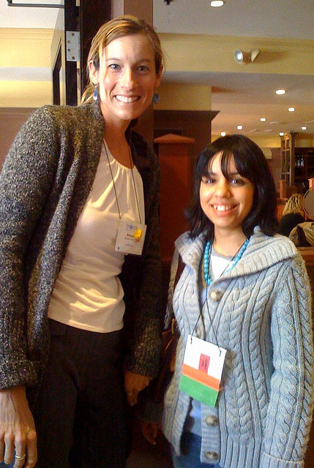
Warm Up: True or False?
Taller people make more money.
If I was paid more, I’d work harder.
People who are “outgoing” make better leaders.
IO psychologists want to discriminate between job applicants/employees.
Personality tests predict employee performance better than intelligence tests.
Notes:
Purpose:
This is an activity that can take place before students review the content in class. You can use it to see what students know, introduce concepts from IO psychology, and as a fun way to include some of the more interesting research findings from IO.
Time:
5-10 minutes depending on how many statements you include and how long you want to talk about each statement
Materials:
Depending on how you record responses, you may need i-clickers, or pen and paper, or nothing at all.
Directions:
A statement will appear on the slide and students will have to decide if the statement is true or false (you can use i-clickers, have students raise their hands, write it down, etc. One fun way to do this is to have students stand-up and actually pick a side. They can be hesitant at first, but just encourage them and don’t let anyone stand in the middle!). Once they have picked a side for the statement, you can ask them why they think that and then talk about what the research actually says.
Statements:
(Click): Taller people make more money.
True! Judge and Cable (2004) found that physical height is significantly related to measures of social esteem, leader emergence, and performance. These relationships were true for men AND women. Finally, height is positively related to income after controlling for sex, age, and weight.
(Click): If I was paid more, I would work harder
Mostly false. Though financial incentives work to attract people to jobs (we all like to make money!) and work for short amounts of time, they tend to be ineffective in the long run. Financial incentives such as raises, bonuses, and promotions only motivate people for about 3-6 months. So as IO psychologists, we have to find another way!
(Click): People who are outgoing make better leaders
False! Though being extraverted is related to emerging as a leader, it doesn’t actually mean that person will be effective. Conversely, just because someone is introverted, does not mean that they won’t be an effective leader (it just may take a little more time for others to see them as leaders). In fact, sometimes someone who is outgoing can push a group into make a bad decision (because they are outgoing enough to “lead” the group, but aren’t necessarily knowledgeable or qualified to make decisions/suggestions).
(Click): IO psychologists want to discriminate between job applicants/employees
True! An IO psychologist’s entire job is to discriminate between people: who will be the best person for the job? Who is the highest performer? Who should get a promotion/raise? The key to this is that they want to FAIRLY discriminate between employees (in this context, you can think of discrimination as the same as differentiation). Again though, they don’t want to unfairly discriminate between employees. For example, IO psychologists want to find the highest performer and give them the raise (FAIR discrimination) instead of giving someone a raise based on race, gender, religion, etc. (UNFAIR discrimination). This is a really important distinction!
(Click): Personality tests predict employee performance better than intelligence tests.
False! Though personality tests do tell us things that we are interested in (is this employee likely to steal from the organization? Will they get along with their coworkers?), the BEST predictor of an employee’s job performance is their intelligence.
Reference:
Judge, T. A., & Cable, D. M. (2004). The effect of physical height on workplace success and income: preliminary test of a theoretical model. Journal of Applied Psychology, 89(3), 428.

Slide 4
Overview
What Is IO Psychology?
What Does an IO Psychologist Do?
Careers in IO Psychology
History of IO Psychology
Notes:
Overview slide
Shows all major topics to be covered as well as significant sub-topics (sub topics that have at least 1 slide of their own)
This slide helps students see the “big picture” of your lecture, which makes it easier to make connections between topics.

Slide 5

What Is IO Psychology?
Scientific study and application of psychology to understand work behavior
How does IO psychology relate to you and your future career?
Notes:
Purpose:
This slide is meant to introduce students to the field of IO psychology – one of the least well known areas of psychology.
Notes:
What is I/O psychology?
(Click): Scientific study and application of psychology to understand work behavior
Briefly, it can be defined as the scientific study of behavior in organizational settings and the application of psychology to understand work behavior. In other words, while general psychology concerns itself with behavior of individuals in general, I/O psychology focuses on understanding employee behavior in work settings.
For example, they ask questions such as: How can organizations recruit and select the people they need in order to remain productive? How can organizations assess and improve the performance of their employees? What work and non-work factors contribute to the happiness, effectiveness, and well-being of employees in the workplace? How does work influence non-work behavior and happiness? What motivates employees at work? All of these important queries fall within the domain of I/O psychology.
At this point you may be asking yourself: Does psychology really need a special field to study work behaviors? In other words, wouldn't’t the findings of general psychology be sufficient to understand how individuals behave at work? The answer is an underlined no. Employees behave differently at work compared with how they behave in general. While some fundamental principles of psychology definitely explain how employees behave at work (such as selective perception or the desire to relate to those who are similar to us), organizational settings are unique. To begin with, organizations have a hierarchy. They have job descriptions for employees. Individuals go to work not only to seek fulfillment and to remain active, but also to receive a paycheck and satisfy their financial needs. Even when they dislike their jobs, many stay and continue to work until a better alternative comes along. All these constraints suggest that how we behave at work may be somewhat different from how we would behave without these constraints.
(Click): How does IO psychology relate to you and your future career?
This discussion is to help students apply what it means to be an IO psychologist to their personal life.
Findings of I/O psychology are useful and relevant to everyone who is planning to work in an organizational setting. Note that we are not necessarily taking about a business setting. Even if you are planning to form your own band, or write a novel, or work in a not-for-profit organization, you will likely be working in, or interacting with, organizations. Understanding why people behave the way they do will be useful to you by helping you motivate and influence your coworkers and managers, communicate your message more effectively, negotiate a contract, and manage your own work life and career in a way that fits your life and career goals.

Slide 6
Overview
What Is IO Psychology?
What Does an IO Psychologist Do?
Careers in IO Psychology
History of IO Psychology
Notes:
Mid-lecture Overview

Slide 7
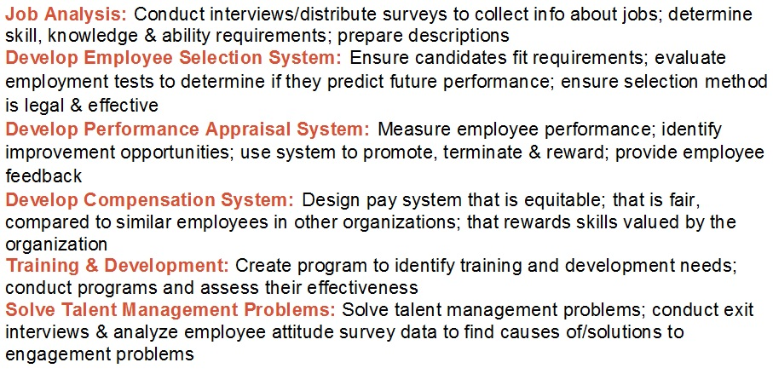
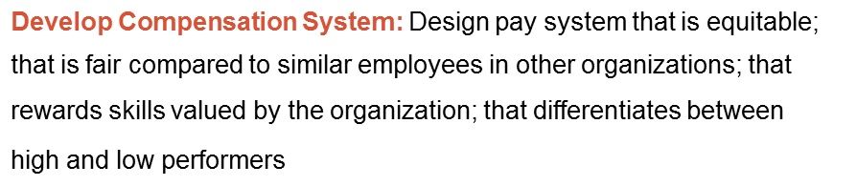
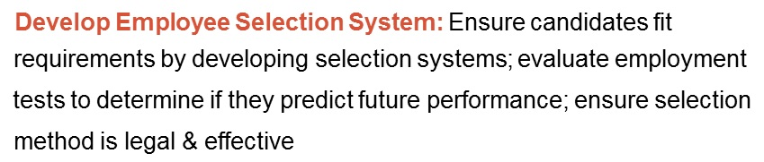
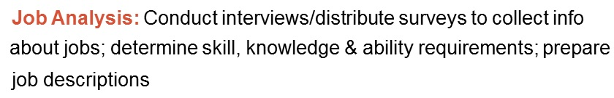

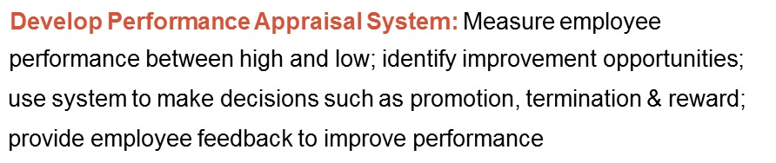
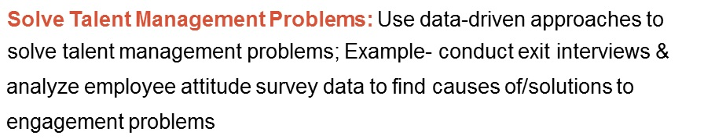
What Does an IO Psychologist Do?
How can orgs. assess & improve the performance of their employees?
How does work influence non-work behavior and happiness?
What motivates people to work?
Notes:
This slide has students discuss the ideas just presented about interpersonal functions of emotions.
Think → Pair → Share: Have students think about each question and jot down some ideas on a paper or in their notes. After, have them pair up to share their responses. After they have shared their answers with one another, have them turn to a different partner and share their answers again. End the activity by having the class discuss the ideas together as a large class.
Discussion Questions:
(Click): How can organizations assess and improve the performance of their employees?
Using the infographic from the module as a starting place, students can hypothesize how organizations can assess the performance of their employees (e.g., using a job analysis as an assessment tool, they could use training to improve performance, compensation incentives to improve performance, etc.).
(Click): How does work influence non-work behavior and happiness?
Based on their current knowledge from the reading, this is more of an opinion-based question where they can draw on their experiences with jobs they loved or hated. You can also remind them that individuals go to work not only to seek fulfillment and to remain active, but also to receive a paycheck and satisfy their financial needs. Even when they dislike their jobs, many stay and continue to work until a better alternative comes along. All these constraints suggest that how we behave at work may be somewhat different from how we would behave without these constraints. Thus, work definitely influences our behavior, including our non-work behavior and happiness. Specifically, how happy we are with our jobs and our careers is a primary predictor of how happy and content we are with our lives in general (Erdogan, Bauer, Truxillo, & Mansfield, 2012).
(Click): What motivates people to work?
This should be more of a brainstorming discussion question. Based on the first slide (popular myths regarding IO psych), they should already know that money alone is not a major contributor. Given that information as a prompt, you can ask them what else might influence an individual’s motivation at work (for either better or worse).
Reference:
Erdogan, B., Bauer, T. N., Truxillo, D. M., & Mansfield, L. R. (2012). Whistle while you work a review of the life satisfaction literature. Journal of Management, 38(4), 1038-1083.

Slide 8

What Does an IO psychologist Do?
Research
Consulting
  Internal vs. External
Notes:
Purpose:
This slide is meant to help students understand exactly what an IO psychologist does – since most people don’t know, this will be an informative discussion!
Notes:
(Click): Research
Similar to other scientific fields, it uses research methods and approaches, and tests hypotheses. However, I/O psychology is a social science. This means that its findings will always be less exact than in physical sciences. Physical sciences study natural matter in closed systems and in controlled conditions. Social sciences study human behavior in its natural setting, with multiple factors that can affect behavior, so their predictive ability will never be perfect. While we can expect that two hydrogen and one oxygen atom will always make water when combined, combining job satisfaction with fair treatment will not always result in high performance. There are many influences on employee behaviors at work, and how they behave depends on the person interacting with a given situation on a given day.
Despite the lack of precise results, I/O psychology uses scientific principles to study organizational phenomena. Many of those who conduct these studies are located at universities, in psychology or management departments, but there are also many who work in private, government, or military organizations who conduct studies about I/O-related topics. These scholars conduct studies to understand topics such as “What makes people happy at work?” “What motivates employees at work?” “What types of leadership styles result in better performance of employees?” I/O psychology researchers tend to have a Ph.D. degree, and they develop hypotheses, find ways of reasonably testing those hypotheses in organizational settings, and distribute their findings by publishing in academic journals.
(Click): Consulting
I/O psychology is based on the scientist-practitioner model. In other words, while the science part deals with understanding how and why things happen at work, the practitioner side takes a data-driven approach to understand organizational problems and to apply these findings to solving these specific problems facing the organization. While practitioners may learn about the most recent research findings by reading the journals that publish these results, some conduct their own research in their own companies, and some companies employ many I/O psychologists. Google is one company that collects and analyzes data to deal with talent-related issues. Google uses an annual Googlegeist (roughly translating to the spirit of Google) survey to keep tabs on how happy employees are. When survey results as well as turnover data showed that new mothers were twice as likely to leave the company as the average employee, the company made changes in its maternity leave policy and mitigated the problem (Manjoo, 2013). In other words, I/O psychologists both contribute to the science of workplace behavior by generating knowledge and solve actual problems organizations face by designing the workplace recruitment, selection, and workforce management policies using this knowledge.
(Click): Internal vs. External
Internal consultants are consultants that work for ONE company and usually services a variety of HR needs (selection, leadership development, engagement, motivation, etc.). These are usually at larger companies like Google, Wal-Mart, Target, etc. (think Fortune 500 of Fortune 1000 companies).
External: consultants who work for a larger consulting firm that employees several IO psychologists that are hired out to companies on a project/contract basis. For example, a construction company that is having problems with worker safety might hire an IO psychologist to help them figure out how to make sure that employees are following safety protocol (wearing their personal protective equipment, using tools as directed, etc.). Consulting firms that hire IO psychologists include DDI, HUMRRO, Valtera, and Kenexa.
Reference:
Manjoo, F. (2013). The Happiness Machine: How Google became such a great place to work. Slate Magazine.

Slide 9
Overview
What Is IO Psychology?
What Does an IO Psychologist Do?
Careers in IO Psychology
History of IO Psychology
Notes:
Mid-lecture Overview

Slide 10

Careers in IO Psych
Organizations
Government
Universities
How do you think the job context influences the job of an IO psychologist?
Notes:
Purpose:
The purpose of this slide is to begin discussion on the careers in IO Psychology and the different areas where they get to apply their skills and experience.
(Click): Organizations
For-profit companies: Google, Target, Wal-Mart, CocaCola, etc.
Non-Profit: Hospitals, mental health facilities, charities, etc.
(Click): Government
Branches of the government include the NSA, FBI, etc.
Military units use IO a lot for leadership development, efficiency, placement testing (selection), etc.
(Click): Universities
Public, private, teaching focused or research focused
(Click):
Discussion Question:
How do you think the job context (public, private, non-profit, research, consulting, etc.) influence s the job of an IO psychologist?
Can influence pay, job demands (external consultants tend to travel a lot more than any other type), researchers and academicians are expected to conduct research and publish findings, consultants have to demonstrate value and concentrate more on sales, etc.

Slide 11
Careers in IO Psych
Fun Facts
Average Yearly Salary:
$76,950
Projected Growth by 2022:
22% increase
(highest growing job)
Preparation Needed:
48% have Masters
47% have PhD
Best Suited for:
Investigative, Enterprising, and Artistic People
Notes:
Purpose:
The purpose of this slide is to give students some specific information about careers in IO (all info based on published national data from onetonline.org; based on U.S> Bureau of Labor statistics).
(Click): Average yearly Salary: $76,950
However, this depends on several factors – PhDs make more than masters; consultants make more than academics, size of organization, etc.
(Click): Projected growth: 22%
IO psychologists were rated as the fastest growing profession in 2014
(Click): Preparation Needed
Almost every IO psychologists has a degree beyond undergraduate. The 5% unaccounted for by the figures in the slide are for IO psychologists who have post-doc positions. If students are interested in this career, they should definitely know the preparation is needed!
(Click): Best Suited for Investigative, Enterprising & Artistic People
This is based on data from o*net online. However, social people are also well-suited to this position.
Investigative
Investigative occupations frequently involve working with ideas, and require an extensive amount of thinking. These occupations can involve searching for facts and figuring out problems mentally. See more occupations related to this interest such as Assessment Services Manager, Organizational Consultant, Organizational Development Consultant, etc.
Enterprising
Enterprising occupations frequently involve starting up and carrying out projects. These occupations can involve leading people and making many decisions. Sometimes they require risk taking and often deal with business. See more occupations related to this interest.
Artistic
Artistic occupations frequently involve working with forms, designs and patterns. They often require self-expression and the work can be done without following a clear set of rules.

Slide 12

Activity: Thinking Like an IO Psychologist
Analyze job of a professor through eyes of IO psychologist:
  What does a professor DO?
  How would you analyze job performance?
  What motivates professors?
  What characteristics might predict whether or not someone is a good professor?
  How does a university influence the performance of professors?
Notes:
Purpose:
The goal of this activity is to help students get into the mindset of an IO psychologist – how does an IO psychologist think about work? We know that work life isn’t all about money – so what’s it about? By looking into one specific job (professor), students can get a more clear idea of how IO psychologists understand employees and organizations.
Time:
5-10 minutes depending on depth of discussion.
Materials:
none (unless you want them to write it down instead of discuss)
Directions:
Have students analyze the job of a professor through the eyes of an IO psychologist. To help with this process, you can give them the following prompts:
(Click): What does a professor DO?
Here, get them thinking about the complexities of being a professor. Most professors have teaching, research, and university service obligations (as a side benefit, you can help students understand the complex jobs most professors have – students often don’t realize that professors do other things and not just teach!).
Some specific behaviors: preparing lecture, delivering lecture, creating assignments and tests, grading papers, tests and assignments, conducting research, analyzing data, writing up reports, attending conferences, mentoring graduate and undergraduate students (help with advising, reading theses/dissertations, etc.), overseeing TAs and RAs, acting as reviewer for journals and conference submissions, faculty advisor for organizations, serving on various committees, etc. The list goes on!
(Click): How would you analyze their job performance?
Hopefully, you get a complicated response (because performance is complicated – it’s not just a straightforward assessment). Students should take into account the different areas of performance (teaching vs. research vs. service). How should we assess teaching performance? We know from the research that relying solely on student evaluations may not be effective, so what other options? How do we evaluate a professor’s research contribution? Should we look at quantity or quality? If we decide to look at quality, how do we decide what quality is and what it is not? What about service? How do measure a professor’s service to the department, university, and community?
(Click): What motivates professors? How could you increase their motivation?
Most students are aware enough to know that most college professors aren’t making a lot of money (most could make more money by working in the industry). So if professors aren’t working for money, what are they working for? What motivates them? What can the university do to keep them motivated and productive?
(Click): What characteristics might predict whether or not someone is a good professor?
Think of it this way: if we wanted to select the BEST professor, what would we look for? Intelligence? Personality traits? Work habits?
(Click): How does the university influence the performance of professors?
This should get the students thinking about the contextual factors associated with professor job performance. Employees don’t exist in a vacuum and the environment certainly influences what employees are capable of doing. For example – what if the university doesn’t have money for research? The result might be that the professor doesn’t have the participants, equipment, statistical software, etc. they need to effectively do their job. Or what if the university demands an unreasonable amount of publications each year? Then maybe that professor doesn’t have much time for service or teaching (so those ratings might be low).

Slide 13
Overview
What Is IO Psychology?
What Does an IO Psychologist Do?
Careers in IO Psychology
History of IO Psychology
Notes:
Mid-lecture Overview

Slide 14

History of IO
Major Players
  Hugo Munsterberg
  Frederick Taylor
  Lillian Gilbreth
Notes:
Purpose:
The purpose of this slide is create the context for students to understand the development of IO psychology as a science. By understanding the “major players” of IO psychology, students can see how IO psychology has changed over time.
(Click): Hugo Munsterberg
The term “founding father” of I/O psychology is usually associated with Hugo Munsterberg of Harvard University. His 1913 book on Psychology and Industrial Efficiency, is considered to be the first textbook in I/O psychology. The book is the first to discuss topics such as how to find the best person for the job and how to design jobs to maintain efficiency by dealing with fatigue.
(Click): Frederick Taylor
One of his contemporaries, Frederick Taylor, was not a psychologist and is considered to be a founding father not of I/O psychology but of scientific management. Despite his non-psychology background, his ideas were important to the development of the I/O psychology field, because they evolved at around the same time, and some of his innovations, such as job analysis, later became critically important aspects of I/O psychology. Taylor was an engineer and management consultant who pioneered time studies where management observed how work was being performed and how it could be performed better. For example, after analyzing how workers shoveled coal, he decided that the optimum weight of coal to be lifted was 21 pounds, and he designed a shovel to be distributed to workers for this purpose. He instituted mandatory breaks to prevent fatigue, which increased efficiency of workers. His book Principles of Scientific Management was highly influential in pointing out how management could play a role in increasing efficiency of human factors.
(Click): Lillian Gilbreth
Lillian Gilbreth was an engineer and I/O psychologist, arguably completing the first Ph.D. in I/O psychology. She and her husband, Frank Gilbreth, developed Taylor’s ideas by conducting time and motion studies, but also bringing more humanism to these efforts. Gilbreth underlined the importance of how workers felt about their jobs, in addition to how they could perform their jobs more efficiently. She was also the first to bring attention to the value of observing job candidates while they performed their jobs, which is the foundation behind work sample tests. The Gilbreths ran a successful consulting business based on these ideas. Her advising of GE in kitchen redesign resulted in foot-pedal trash cans and shelves in refrigerator doors. Her life with her husband and 12 kids is detailed in a book later made into a 1950 movie, Cheaper by the Dozen, authored by two of her children.

Slide 15
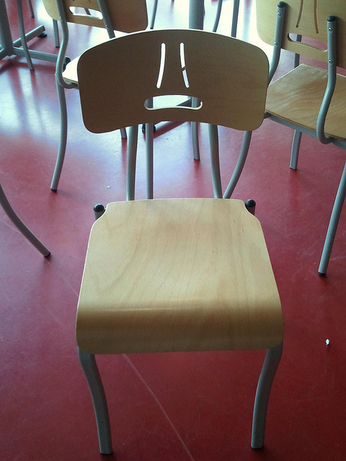
Activity: Bad Designs
www.baddesigns.com
Follow up discussion
  Why does “bad design” matter?
  What kinds of considerations should IO psychologists make when thinking about work design?
Notes:
Purpose:
The goal of this activity is to show students some examples of “Human Factors” engineering that a lot of the founders concentrated on. Though human factors only comprises a small percent of current IO psychologists, it is an important part of the IO history!
Time:
5-10 minutes depending on depth of explanation and number of examples used.
Materials:
none (unless you want them to write it down instead of discuss)
Overview (from P. Bachiochi):
Sometimes the best way to illustrate a concept is to explain when it’s not happening. For instance, various sensation and perception concepts can be demonstrated very well via a discussion of optical illusions. Various optical illusions take advantage of perceptual cues to create images that simply can’t exist. Covering Human Factors can also benefit from a similar approach. Textbooks often diagram the design of a workspace to illustrate how form and function can coexist to facilitate performance. However, more memorable images for students exist in their daily environment when they consider the things around them that don’t work the way that they’re supposed to work.
Michael J. Darnell has compiled a website (www.baddesigns.com) that outlines many objects that break basic design rules and using this site in class provides multiple vivid (and humorous) examples. In addition to providing photos and descriptions, Darnell also provides clear and interesting descriptions of just why the designs don’t work. Given that many users have sent in examples after seeing the website, there are often colorful stories of problems encountered during product use.
Directions:
Pull up the bad designs website (www.baddesigns.com) and browse some of the products (you might want to do this ahead of time so you can pick out 3-5 of the most interesting/funny examples).
Say: “For each product I show you, try to figure why it is a “bad design.” Then, try to come up with your own solution of how to fix the design flaw”.
Based on the examples you select, the class can talk about similar design issues they have experienced and you can help use this discussion to illustrate the type of work that early IO psychologists investigated. You could also talk about more recent iterations of this type of research, such as IO psychologists helping to design the interior of airplane cockpits to help pilots more easily navigate their complex controls.
You could also talk about the number of deaths associated with product use – specifically that most products are designed with right-handed people in mind, which leads to the death of several left-handed people each year (because they were using an improperly designed product). Though it’s sad, it is a good example of the importance and relevance of the work of early IO psychologists.
Follow Up Discussion Questions:
(Click): Why does “bad design” matter?
Here, you want them thinking like an IO psychologist. That is, other than from a customer standpoint, why might bad design matter? How might it influence employee satisfaction, worker safety, etc. For example, hundreds of left handed workers are injured each year due to using equipment designed for right handed people. You can use this example to get them thinking about the implications of bad design.
(Click): What kinds of considerations should IO psychologists make when thinking about work design?
Again, this is mostly a brainstorming type of question. Things to think about include efficiency, the potential for injury, complexity, etc.
Image: Though it may be a sign of Pareidolia (human propensity to see a pattern that forms a face, even if such pattern is random) one cannot help but see a sad face on that chair. It looks as though the chair would really rather you not sit on it.

Slide 16
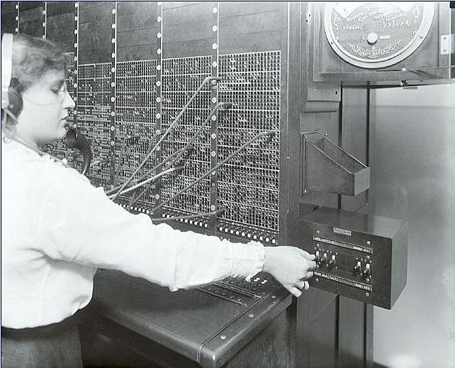
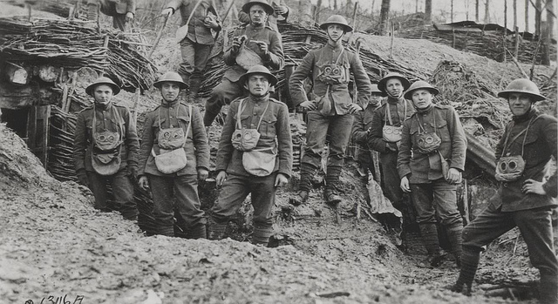
History of IO
Important Events
  WWI
  Hawthorne Studies
Notes:
Purpose:
In continuation of the previous slide, the purpose of this slide is create the context for students to understand the development of IO psychology as a science. By understanding important events that shaped the field of IO psychology, students can see how IO psychology has changed over time.
Important Events:
(Click): WWI
World War I was a turning point for the field of I/O psychology, as it popularized the notion of testing for placement purposes. During and after the war, more than 1 million Americans were tested, which exposed a generation of men to the idea of using tests as part of selection and placement. Following the war, the idea of testing started to take root in the private industry. American Psychological Association President Robert Yerkes, as well as Walter Dill Scott and Walter Van Dyke Bingham from the Carnegie Institute of Technology (later Carnegie Mellon University) division of applied psychology department were influential in popularizing the idea of testing by offering their services to the U.S. Army.
(Click): Hawthorne Studies
Another major development in the field was the Hawthorne Studies, conducted under the leadership of Harvard University researchers Elton Mayo and Fritz Roethlisberger at the Western Electric Co. in the late 1920s. Originally planned as a study of the effects of lighting on productivity, this series of studies revealed unexpected and surprising findings. For example, one study showed that regardless of the level of change in lighting, productivity remained high and started worsening only when it was reduced to the level of moonlight. Further exploration resulted in the hypothesis that employees were responding to being paid attention to and being observed, rather than the level of lighting (called the “Hawthorne effect”). Another study revealed the phenomenon of group pressure on individuals to limit production to be below their capacity. These studies are considered to be classics in I/O psychology due to their underlining the importance of understanding employee psychology to make sense of employee behavior in the workplace.

Slide 17

Wrap Up Discussion
How does IO psychology relate to you and your future career?
How do you think the job context influences the job of an IO psychologist?
How does the current economy and workforce influence the field of IO psychology?
Notes:
This slide introduces the wrap-up discussion.
How does IO psychology relate to you and your future career?
One of APA’s learning goals is to help students think about and prepare for their future careers. Though few students may be interested in IO psychology as their career of choice, it’s still a helpful content area because it can help students understand issues related to their career and organization life. You could have students talk about their future jobs, what an IO psychologist might think about their job, etc. The goal is to get them thinking critically about their future profession.
How do you think the job context (public, private, non-profit, research, consulting, etc.) influences the job of an IO psychologist?
IO psychologists work within a complex framework that is influenced by many contextual factors. Therefore, the goal of this question is to not only reiterate the content (what an IO psychologist does), but also get them thinking critically about external factors that might influence an individual’s job.
How does the current economy and workforce influence the field of IO psychology? What kinds of trends do you think current IO psychologists are facing (e.g., technology, aging workforce, globalization, etc.)?
The face of employment is changing – from globalization to the aging workforce (people are living longer, which means more older workers). Though they might not be interested in these trends per se, these trends will undoubtedly affect their employment. The days of working at a single organization for the duration of your career are long gone – what implications does that have on IO psychologists and the workforce?
Again, the goal here is to get them to think critically about complex, interlaced factors and to also get them thinking about how this influences their future employment.

Slide 18

CAT: The Muddiest Point
  What was the muddiest point about today’s class?
  Write down what concept you are still struggling to understand.
Notes:
Classroom Assessment Technique (CAT): The Muddiest Point
Ask students to write down the “muddiest point” – that is any concept they are still struggling to understand of any questions they still may have about the material. With remaining class time, ask students to share their muddiest point and provide additional review on these points.
Additional Questions:
Reflection & Application (could be done as a one minute paper or class discussion)
How does the current economy and workforce influence the field of IO psychology?
The answer will depend on the current economic conditions in your place of residence and the demand on the IO psychology as a profession in the current labor market.
What kinds of trends do you think current IO psychologists are facing?
If you want to probe a bit more into students’ ability to apply the info, ask them to project what they have learned onto the current trends IO psychologists might face (discussed in the previous slide). You can prompt them with a few trends: technology, again workforce, globalization, diversity, etc. They should take what they have learned and extrapolate to a new context (current trends). This exercise should be less about the students having perfect answers, and more about their critical thinking skills.
If you do not conclude with this Classroom Assessment Technique (CAT), it would helpful to use another CAT. It could be in the form of a:
Muddy point
One-minute paper
Background knowledge
What’s the Principle?
Defining features Matrix:
For more information on CATs click here: http://cft.vanderbilt.edu/guides-sub-pages/cats/

Slide 19
Photo Attribution
Slide 1 | Photo Credit: HA0521-031 We have moved! Please visit /highwaysengland https://www.flickr.com/photos/highwaysagency/5997001123 https://creativecommons.org/licenses/by/2.0/
Slide 3 | Photo Credit: Very tall and very short club Brynn Evans https://www.flickr.com/photos/bmevans/3427175862 https://creativecommons.org/licenses/by-nc-sa/2.0/
Slide 5 | Photo Credit: Business-People-Around-Computer-1 Thanh Trúc Phạm https://www.flickr.com/photos/surikyta_susu/8118175395 https://creativecommons.org/licenses/by-nc-sa/2.0/
Slide 8 | Photo Credit: Flowers & Plants in the Workplace Flower Factor https://www.flickr.com/photos/flowerfactor/5526424073v https://creativecommons.org/licenses/by-nc/2.0/
Slide 10 | Photo Credit: Business Steve wilson https://www.flickr.com/photos/125303894@N06/14387365942/ https://creativecommons.org/licenses/by/2.0/
Slide 12 | Photo Credit: Pitzer College Family Weekend 2015 Day 1 Pitzer College https://www.flickr.com/photos/pitzercollege/16429769777 https://creativecommons.org/licenses/by/2.0/
Slide 14 | Photo Credit: Gear geralt https://pixabay.com/en/gear-gears-function-zsammenspiel-240137/ https://creativecommons.org/publicdomain/zero/1.0/deed.en
Slide 15 | Photo Credit: The chair which didn't smile Clément Gault https://www.flickr.com/photos/56224262@N03/6162124584/ https://creativecommons.org/licenses/by-nc-sa/2.0/
Slide 16 | Photo Credit: World War I Marines with Gas Masks, circa 1918 USMC Archives https://www.flickr.com/photos/usmcarchives/8366713237 https://creativecommons.org/licenses/by/2.0/ Photo Credit: Switchboard Operator 1916 PanelSwitchman https://www.flickr.com/photos/9479603@N02/4551463887 https://creativecommons.org/licenses/by-nc-nd/2.0/
Notes:
Photo Attribution Slide

Slide 20
Photo Attribution
Slide 17 | Photo Credit: Questions1 Grisel D´An https://www.flickr.com/photos/128454566@N06/15893429463 https://creativecommons.org/licenses/by-nc/2.0/
Slide 18 | Photo Credit: Illustrated silhouette of a black cat nehtaeh79 http://www.freestockphotos.biz/stockphoto/16624 http://creativecommons.org/publicdomain/zero/1.0/
Notes:
Photo Attribution Slide

